Slide 1
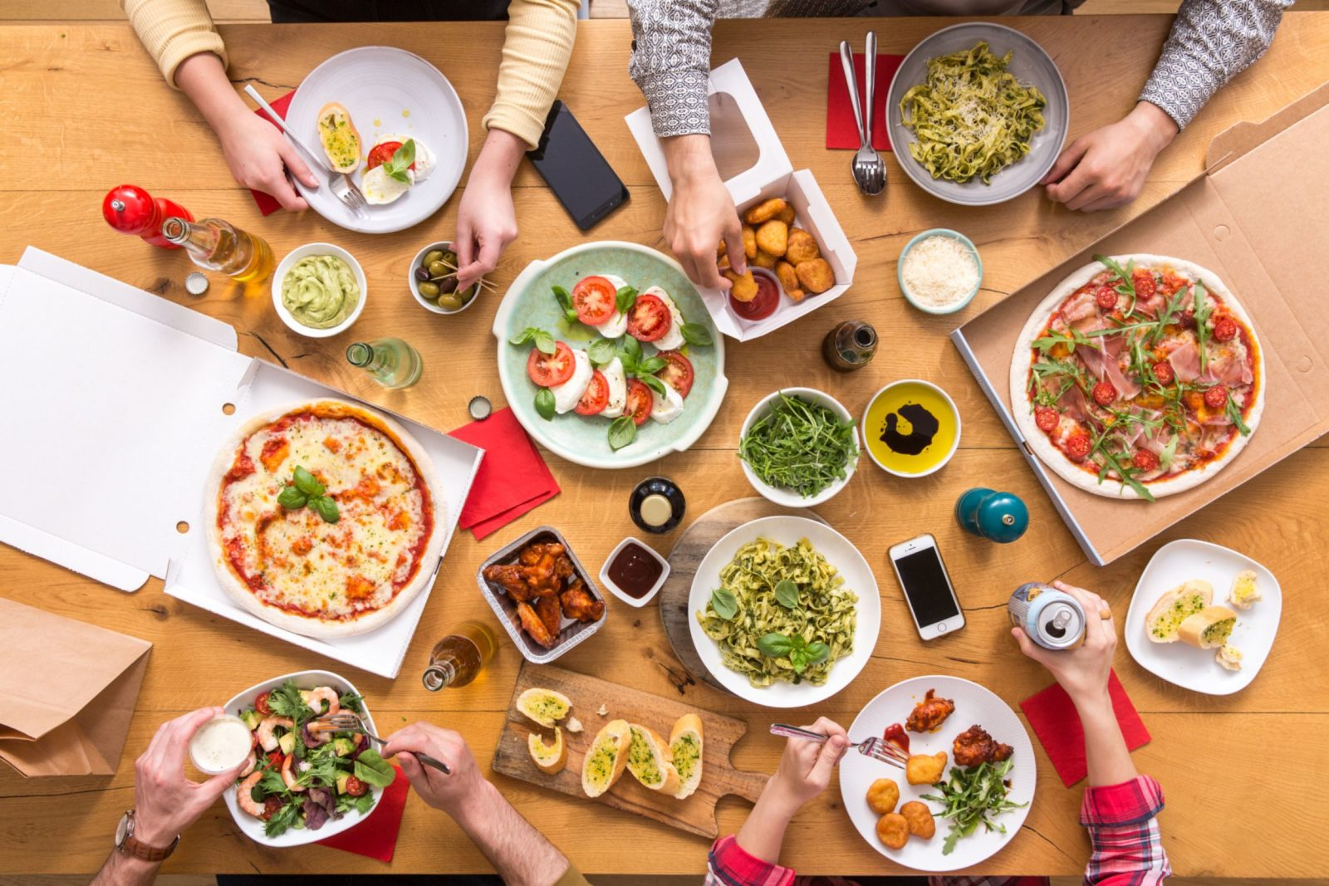



ONLINE PRE ORDERING SYSTEM
FOR RESTAURANTS
INTRODUCING TO SIMME PLATFORM

Slide 2




member of
INTRODUCTION
ABOUT SIMME PLATFORM
Current Situation
Introducing the Solution
Business Opportunities
Global Potential
Online Pre Ordering System
Deniz
Gjonson
Amala

Slide 3
member of
AS–IS SITUATION
PROBLEM IDENTIFICATION @ OFFLINE OPERATING RESTAURANTS
Orders take a long time prepare and serve
Restaurant administration issues / papers missing
Customer order is taken manually
Manual Management / Paper Based

Slide 4
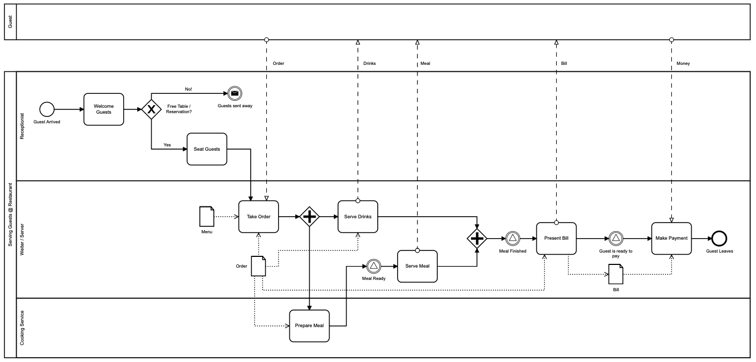
AS–IS PROCESS - BPMN
member of
OFFLINE OPERATING RESTAURANTS

Slide 5
member of
INTRODUCING THE SOLUTION
SIMME PLATFORM SOLUTION
Online Pre Ordering System
Traditional vs. Digital
Time Factor
Customer Satisfaction
Business Opportunity
Hassle Free
“ If you want something new, you have to stop doing something old ”
William Pollard

Slide 6
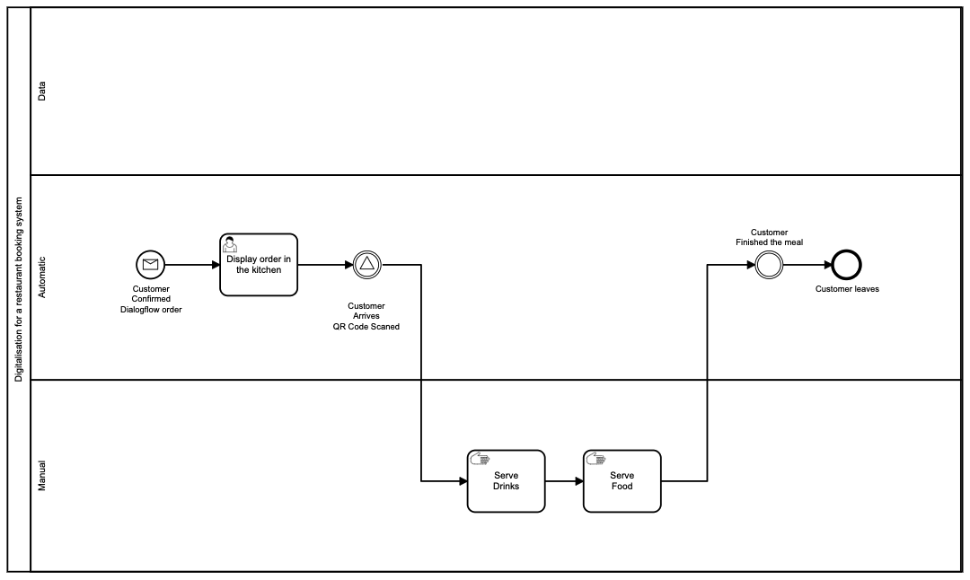
member of
member of
TO–BE PROCESS - BPMN
SIMME PLATFORM SOLUTION

Slide 7
member of
BUSINESS OPPORTUNITIES
SIMME PLATFORM SOLUTION
Digital Era / Society
Enables New Business Model
No Human Involvement
Relieves Customer Pains
Increases Profit
WHY?

Slide 8
member of
BUSINESS OPPORTUNITIES
SIMME PLATFORM SOLUTION
Restaurants
Chains
Franchises
Shopping Malls
Worldwide
Ads
WHERE?

Slide 9
member of
BUSINESS OPPORTUNITIES
SIMME PLATFORM SOLUTION
Kind of this Solution exists in CHINA!
It should work in EUROPE too!

Slide 10
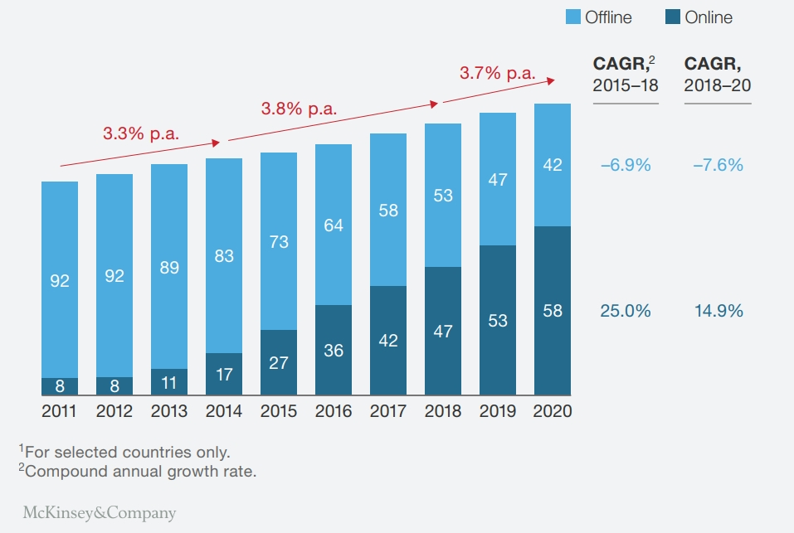
member of
member of
ONLINE ORDERING TRENDS
RESEARCH BASED
THE FOOD-DELIVERY MARKET HAS THE POTENTIAL FOR ROBUST GROWTH.
(McKinsey & Company, 2016)

Slide 11

member of
BENEFITS
SIMME PLATFORM SOLUTION
Reduce time
Flexibility
Predictable Costs
Customer Database
Tracking Orders
Marketing / Advertising
Customer Satisfaction

Slide 12
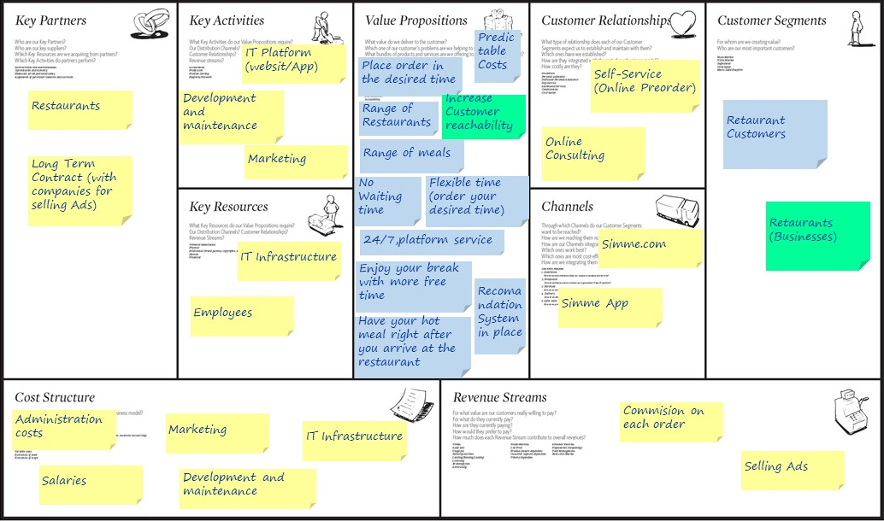

Slide 13
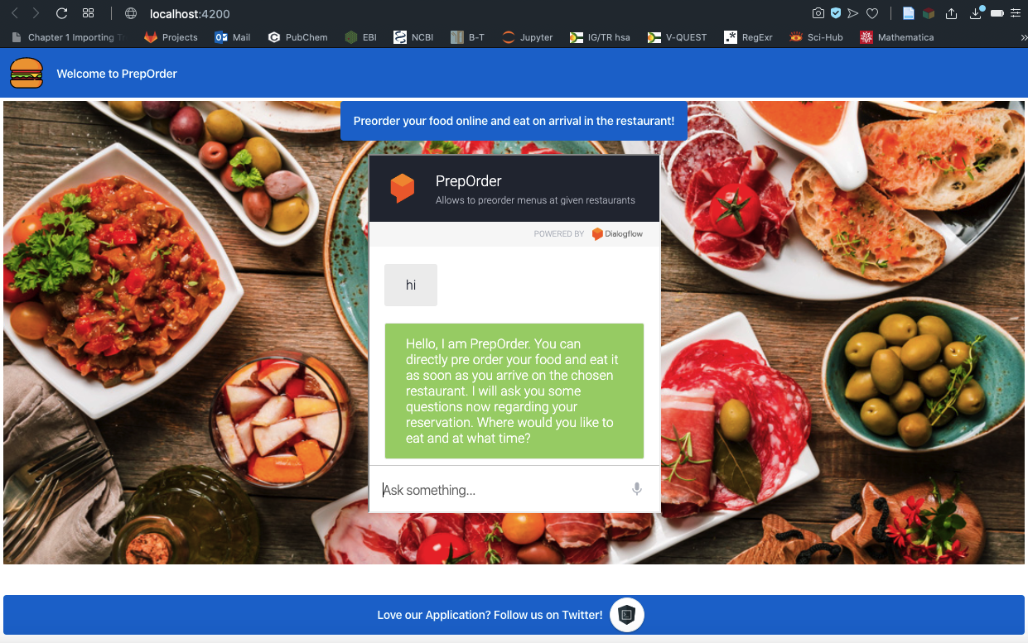
SIMME PLATFORM SOLUTION

Slide 14
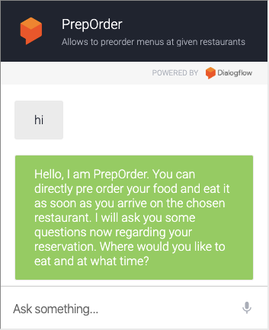

Slide 15
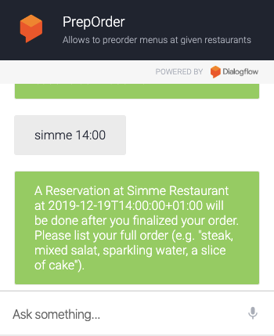

Slide 16
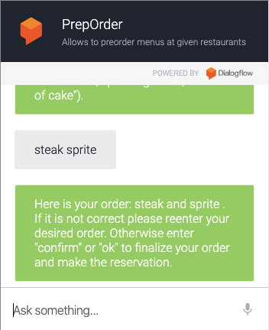

Slide 17
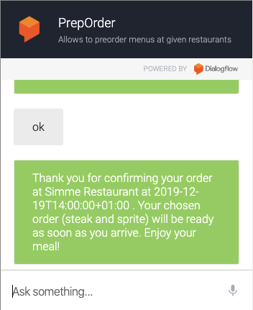

Slide 18
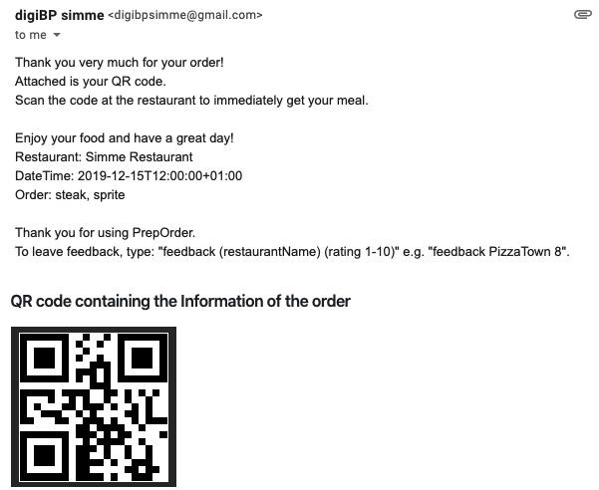

Slide 19
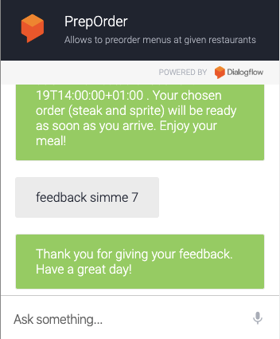

Slide 20
We appreciate your attention!
Thank You!
Questions? Feedbacks? Remarks?

